Slide 1

CEIR Black List Training Manual

Slide 2

Agenda
Feature Overview
Stakeholder Overview
Features
Black List Full File Generation
Black List Incremental File Generation
Download file

Slide 3

Feature Overview
Black List Management Feature allows operator to download black list file which can then be upload in their EIR system to block the devices
The typical flow is as follows
Each end of day, All IMEI for which monitoring period has expired is moved to black list DB
Each end of day, System generate black list file as per frequency
Operator download the file
Upload the file in the EIR system
Two kind of file are generated
Full
Incremental
Grey
DB
Black List DB
Monitoring period has expired
CEIR System
Download
Request
All Operator

Slide 4
Black List
Operator user can download the black list from the CEIR portal
There are 2 kind of files available:
Full – Contain all the IMEI in black list till date
Incremental – Contain the IMEI added/deleted in black list
CEIR System will generate full files on weekly basis and incremental file on daily basis.
Once file is downloaded, the same should be updated on the operator EIR system to bring black list in effect
Operator can either update full dump or keep updating the incremental dump to keep their black list in the EIR database in sync with CEIR on daily basis.

Slide 5
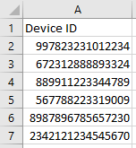
Full File
Frequency to generate file is set as daily/weekly/monthly
File naming format is blacklist_full_yyyymmdd.csv
File contain the IMEI of the device that need to be blacklisted
Frequency | Remarks
Daily | Full file is generated daily
Weekly | Full file is generated weekly. The start of week can be defined as weekday.
Monthly | Full file is generated monthly.

Slide 6
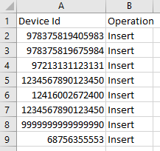
Incremental File
Frequency to generate file is set as daily/ weekly/ monthly
File naming format is blacklist_incrmental_yyyymmdd.csv
File contain two field
IMEI
Operation – Add/Delete. If the number is added in the black list, operation is set as Add. If the number is deleted from the black list, the operation is set as Delete
Frequency | Remarks
Daily | Full file is generated daily
Weekly | Full file is generated weekly. The start of week can be defined as weekday.
Monthly | Full file is generated monthly.

Slide 7
Black List – Add / Delete Scenarios
IMEI is added in black list in following scenarios:
Monitoring period has expired
IMEI is deleted from black list in following scenarios:
Device is marked recovered by lawful agency
Device is requested to be un-blocked by operator
End User pay tax for registered device
End user upload the visa
End user regularize the device by registering and paying tax for same

Slide 8
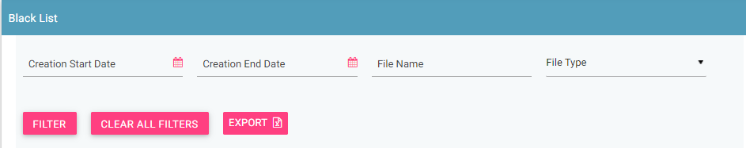
Filter Black list files
Black list files can be filtered on the basis of
Date filters, File Name, File type
The user can use a combination of more than one filters to filter the consignments.
Users can view old files using the date filter.
Clear All Filters can be used to clear filters and refresh the data table.
Export button will export the data based on the filters applied.

Slide 9
Sorting of data
By default, the data displayed is sorted in descending order on last modified date.
Data can be sorted based on other fields by clicking the arrow buttons on the column headers. On first click, data will be sorted in ascending order. On second click, it will be sorted in descending order.

Slide 10
Queries

Slide 11
Thank You

